Slide 1


PHILOSOPHY OF ENGINEERING
Name – Sneha Gupta
Reg. no – RA2511003010163
Year/Semester – 1st
Branch/Section – Btech Cse Core/ C1
Academic year – 2025-2026 odd semester

Slide 2
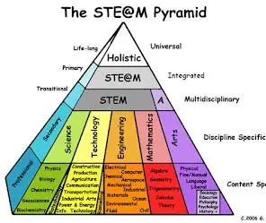
The STEAM Pyramid Is ART Necessary?

Slide 3

What is stem?
Science: search for truth.
Technology: tools & innovation.
Engineering: applied problem solving.
Mathematics: logic & precision

Slide 4

FROM STEM → STEAM
STEM expanded to STEAM with Arts.
Purpose: add creativity, ethics, and design.
Moves beyond utility → to human impact.

Slide 5
SIX LAYERS OF STEAM PYRAMID:
There are six layers in STEAM Pyramid.
Mathematics → Science → Technology → Engineering → Arts
The sixt one is integration layer → Combination of all above five layers.
Arts works as a connector across all layers.

Slide 6
Why some reject arts?
Machines run without aesthetics.
Formulas don’t need color.
Priority: efficiency, survival, cost.
Arts seen as non-essential decoration.

Slide 7
Why Arts matter?
Sparks creativity & innovation.
Improves design, communication, empathy.
Makes technology user-friendly.
Philosophy of engineering → must include human values.

Slide 8

Case Studies:
iPhone → tech + artistic design = global success.
Architecture → function + beauty = legacy.
Medical Visualization → science + art = clarity.

Slide 9
Without vs with ARTS:
Without Art → Strong but lifeless pyramid.
With Art → Inspiring, human-centered, lasting impact.

Slide 10
Philosophical Angle:
Engineering is not just building things.
It is shaping culture, ethics, and society.
Arts in STEAM reminds us: machines serve people, not the other way around.

Slide 11
Conclusion:
Art may not be structurally necessary.
But it is philosophically vital.
STEAM Pyramid = harmony of logic + imagination.
“Engineering is not only to construct, but to inspire.”

